Slide 1

CRM
LIFE CYCLE STAGES & CLV
Lecture Series 04
KHALID BIN MUHAMMAD
Institute of Business Management

Slide 2
CUSTOMER LIFE CYCLE STAGES
Contact phase
Acquisition phase
Retention phase
Loyalty phase

Slide 3
Contact Phase
To gain or to attract new customer through
Marketing
Advertising
Telemarketing
Personal selling
Direct mail
promotions
publicity

Slide 4
Acquisition Phase
The goal is to increase customer retention.
Collect information about customer
Understand their purchase condition / behaviour.
Offer them post-purchase reassurance.
Promote the price-value relationship.
Establish the foundation for a long-term relationship.
Know the associated cost.

Slide 5
Retention Phase
The goal is to create long-term, committed and loyal customers.
Develop a service philosophy.
Increase the responsiveness to customers.
Identify and close service gaps.
Improve the service recovery process.
Measure customer satisfaction.
Reward positive customer behaviour.
Know your retention-related costs.

Slide 6
Loyalty Phase
The goal is to extend customer’s loyalty.
Know their lifetime value and average net worth.
Counteract defection rates and patterns.
Understand loyalty calculations.
Know your costs associated with their loyalty.
Ensure that you know your products inside out
Communicate with the customer.
Learn about the customer.
Provide value on every contact.
Reward the customer’s loyalty

Slide 7
Customer Attrition
Relationship attrition is defined as the number of customers who do not renew their relationship in any one-month, expressed as a percentage of the number of customers at the start of the month.
Attrition is the indicator in measuring the success of customer retention and customer service strategy.

Slide 8
Attrition & Retention
The International Health, Racquet and Sports Enterprise Association (IHRSA) uses the following formula to track retention:
Attrition (%) = [Number of customers lost during a given period (year/month)] ÷ [number of customers at start of same period] x 100.
Attrition + Retention = 100% or equal 1
20% attrition means 80% retention

Slide 9
Challenges with Attrition
Holidays
Summer Customers
Competitor goes out of business
Loss in business due to uncontrollable factors (pool)
Uncontrollable Factors
(House move, death, illness, loss of income, non-payment of relationship fees (uncollectable)
Controllable Factors
(Not using, no time, too expensive)

Slide 10
Customer Life time Value
Customer lifetime value is a measure of customer profitability over time.
CLV can be defined as “a measure of a customer’s aggregate profit to the firm over the total time that the customer is in relationship with the firm”

Slide 11
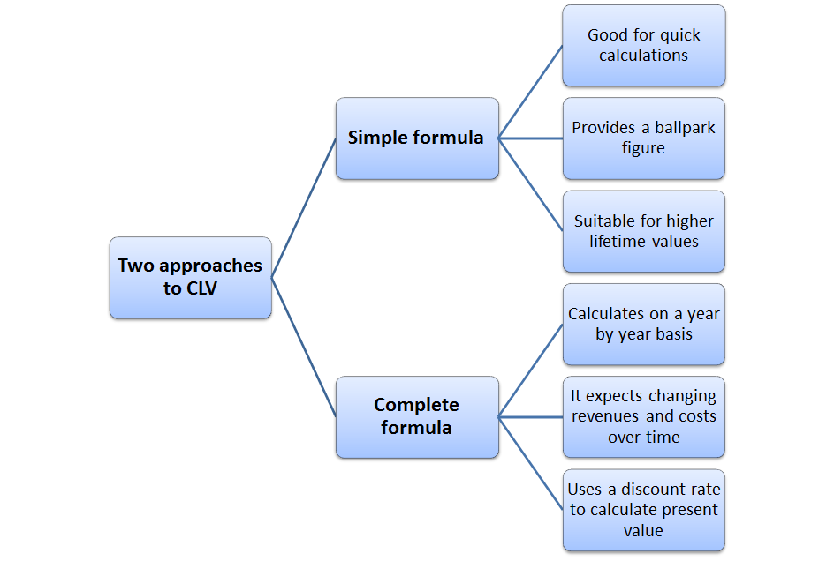
Two Calculation Method

Slide 12
THE SIMPLE CLV FORMULA
SIMPLE CLV CALCULATION FORMULA
Annual profit contribution per customer (MULTIPLY)
Average number of years that they remain a customer
(MINUS) the initial cost of customer acquisition
APCPC X ANOYRC- INCOA
INFORMATION REQUIRED TO CALCULATE CLV?
Initial cost of customer acquisition
Annual profit contribution per customer
Average customer retention rate

Slide 13
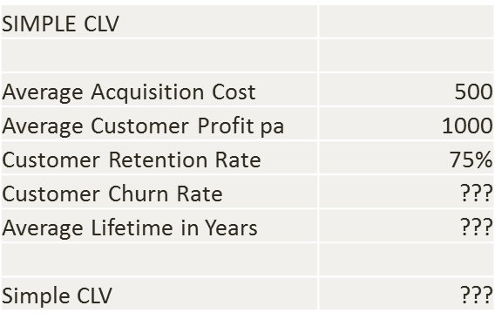
SIMPLE CLV CALCULATION

Slide 14
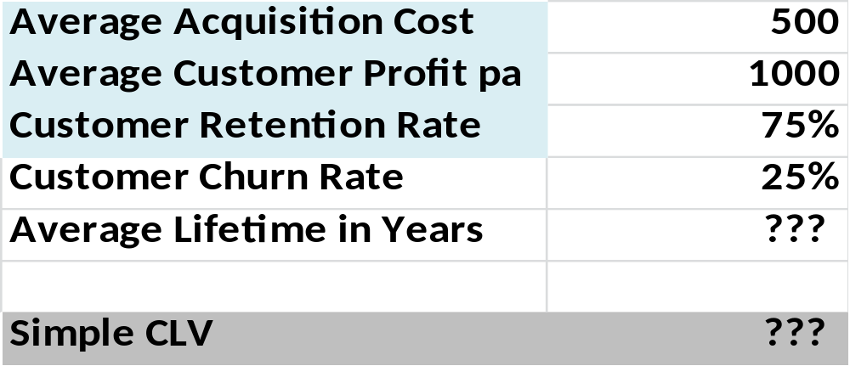
CLV Calculation Step # 1
NOTE: Retention rate and churn (loss) rate always add to 100%

Slide 15
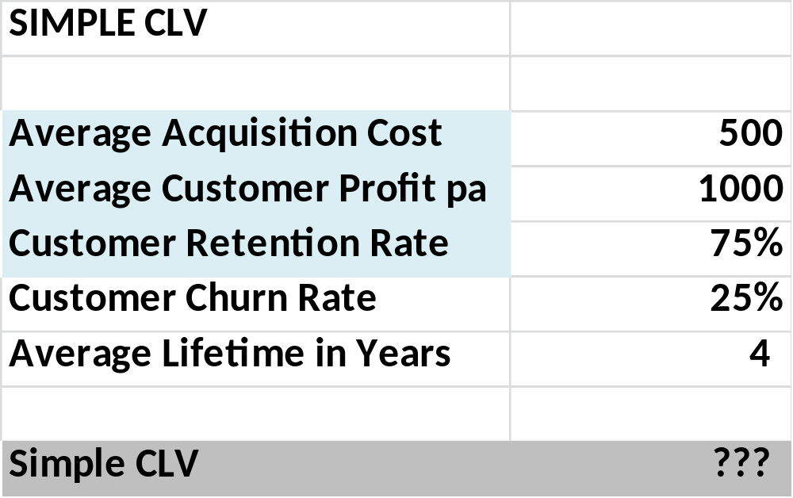
CLV Calculation Step # 2
Average lifetime in years is 1 / churn rate
The number of times the churn rate goes into 100%

Slide 16
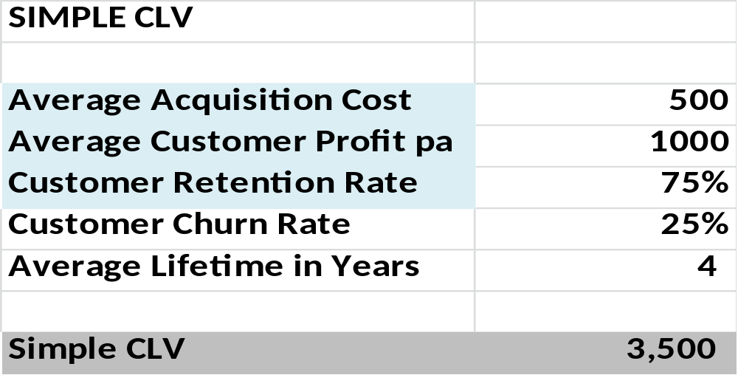
CLV Calculation Step # 3
CLV = time/years X annual profit – acquisition cost
CLV= 4 X $1,000 - $500 = 3500

Slide 17
The Complete CLV Formula
THE FORMULA
Annual profit contribution per customer (for each year) X
The customer retention rate (for each year) less
The initial cost of customer acquisition
With each year adjusted by an appropriate discount rate
INFORMATION REQUIRED?
Initial cost of customer acquisition
Annual revenue contribution per customer
Annual direct costs per customer
Annual customer retention rate
The discount rate to be used

Slide 18

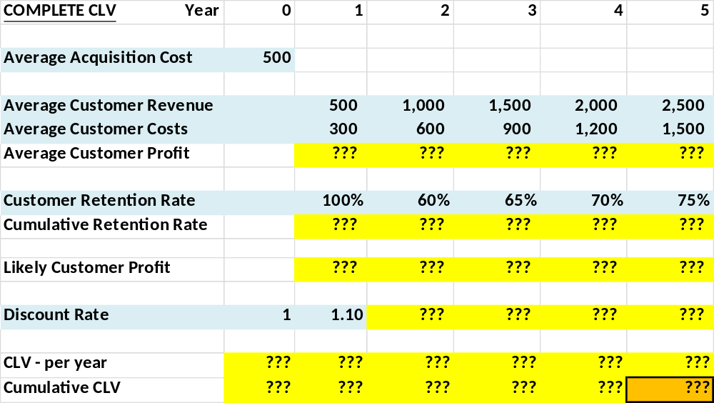
We need to START with the figures in BLUE and we need to CALCULATE the figures in YELLOW
Customer Lifetime Value will be in the bottom-right GOLD cell

Slide 19


Average customer profit each year is simply average customer REVENUE less average customer COSTS

Slide 20

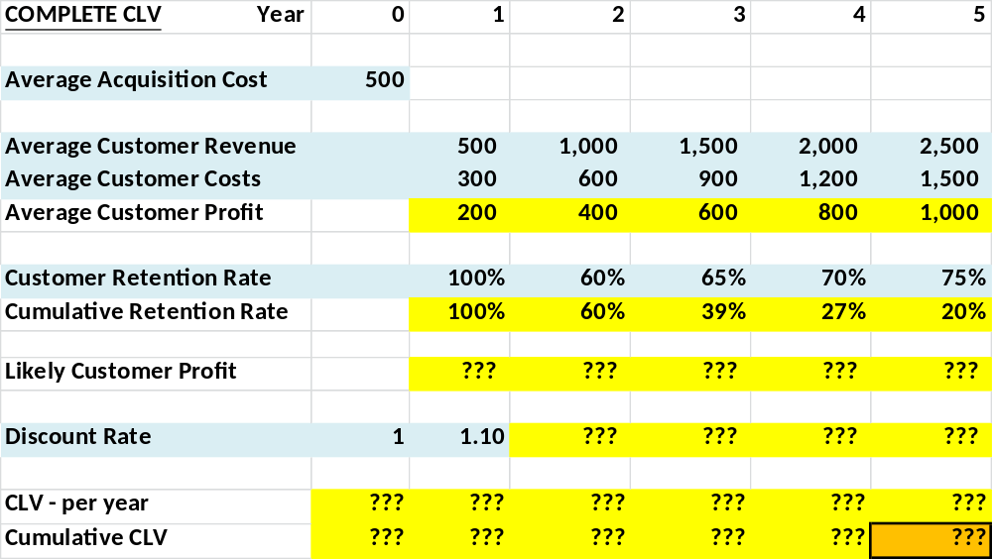
Cumulative retention rate is the compounding effect of losing customers
We start with 100% of customers and we keep 60% in year 2. In year 3 we keep 65% of those remaining, which is 65% of the 60% = 39%
Cumulative retention rate indicates the % probability of receiving the customer’s business (revenues and costs) in future years

Slide 21

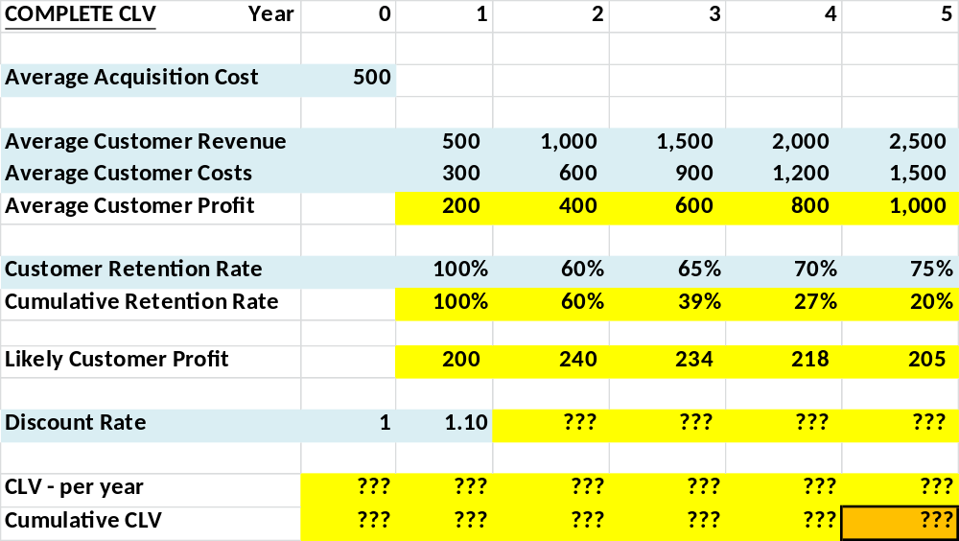
Likely customer profit each year = Average Customer Profit (in row 3) X Cumulative Retention Rate (% probability of the customer still buying from our firm)
Example for Year 3: $600 X 39% = $234

Slide 22


Future discount rates are compounded on a yearly basis
In this case, the discount rate is 10%
Future years are 1.1 X 1.1 = 1.21 X 1.1 = 1.33, and so on

Slide 23

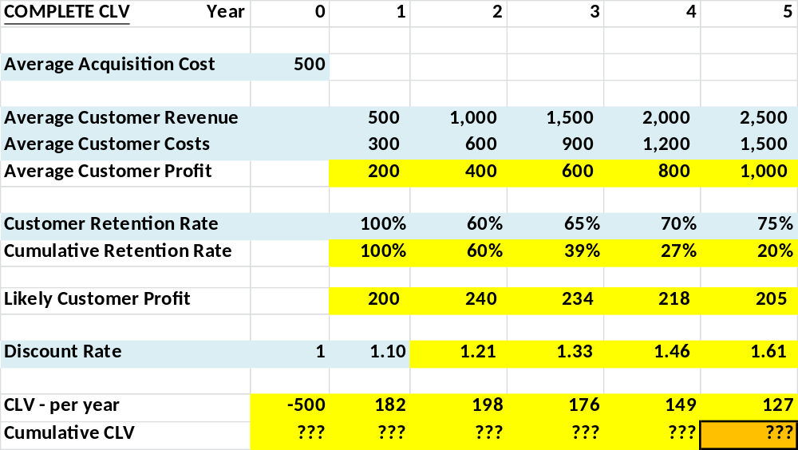
Contribution to CLV on a yearly basis is the “likely customer profit” divided by the discount rate
For example, in year 3: profit = $234 / 1.33 = $176

Slide 24


Cumulative CLV is the running total of CLV per year
Our key CLV figure is in the GOLD cell = $332

Slide 25

CLV = $332 – which is a positive number – which is great
This means that the $500 acquisition cost has generated good profits for the firm
As a 10% discount rate has been used, the ROI on the marketing investment is MORE than a 10% return
Payback on customer acquisition costs is delivered in Year 3

Slide 26


